Slide 1
Predictive Modelling Assignment
Identify Customer Churn based on the given parameters

Slide 2
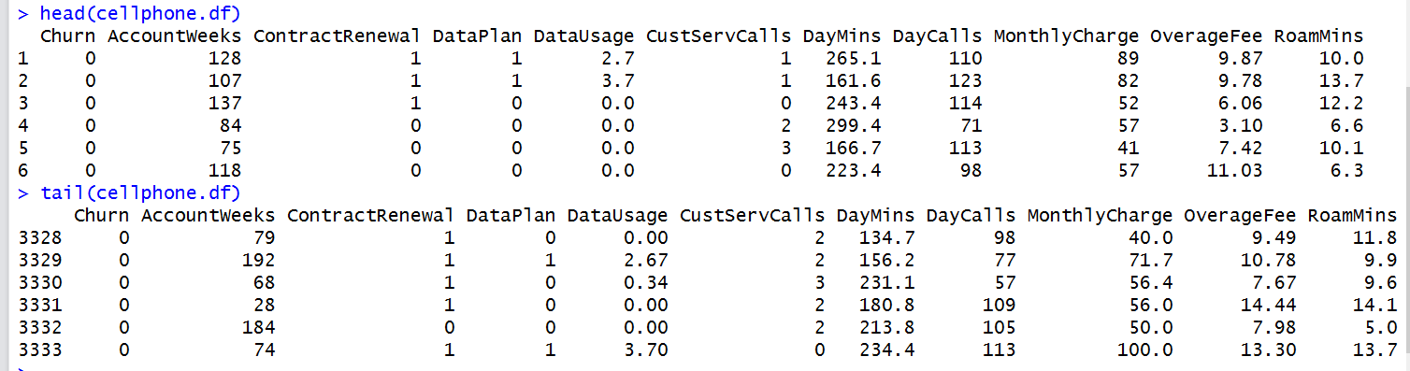
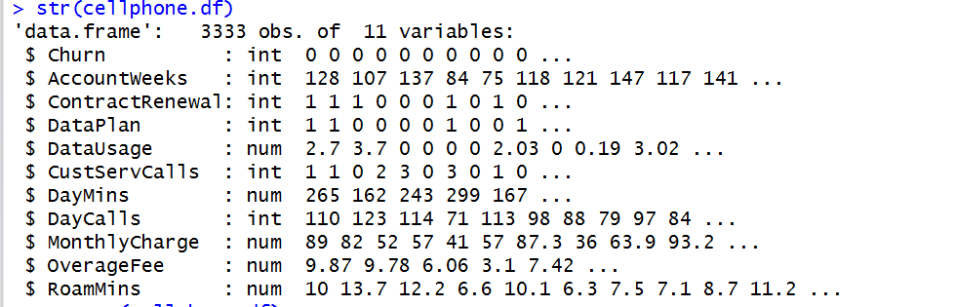
Loading Data and checking the variables type

Slide 3
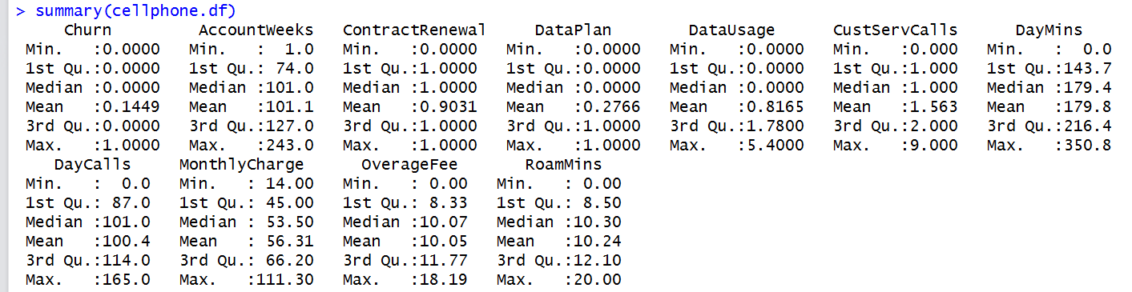
Univariate and Bivariate Analysis
We find that ContractRenewal and Dataplan has 2 values 0 or 1.
No null records present

Slide 4
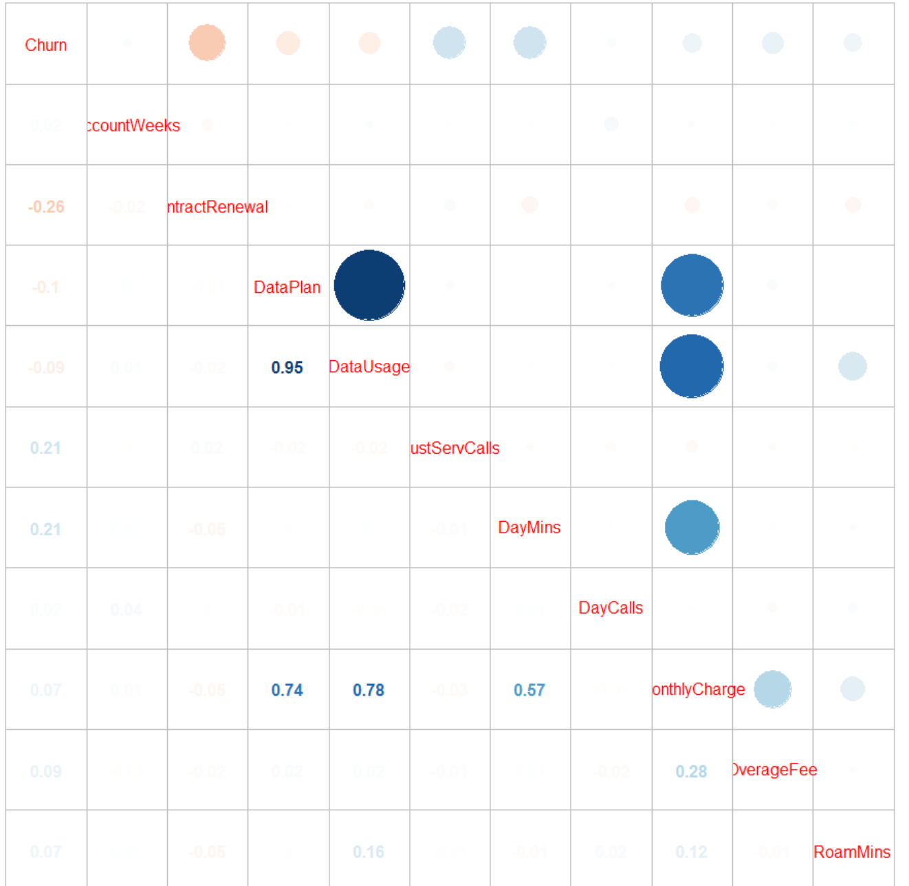
Univariate and Bivariate Analysis
Correlation Plot

Slide 5
Univariate and Bivariate Analysis
Observations:
Dataplan and DataUsage highly correlated
Dataplan and MonthlyCharge highly correlated
Datausage and MonthlyCharge highly correlated
Daymins and MonthlyCharge highly correlated

Slide 6
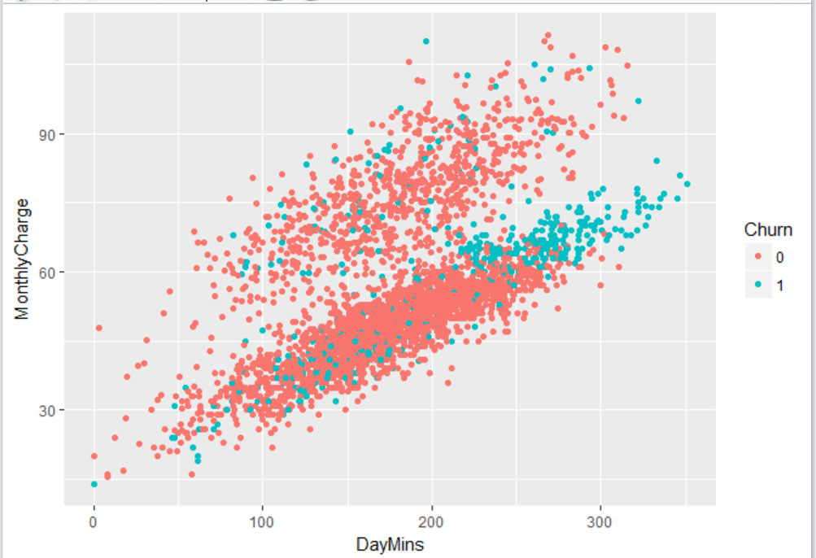
Univariate and Bivariate Analysis
Scatterplot of DayMins and MonthlyCharge. We do see linear positive correlation.

Slide 7
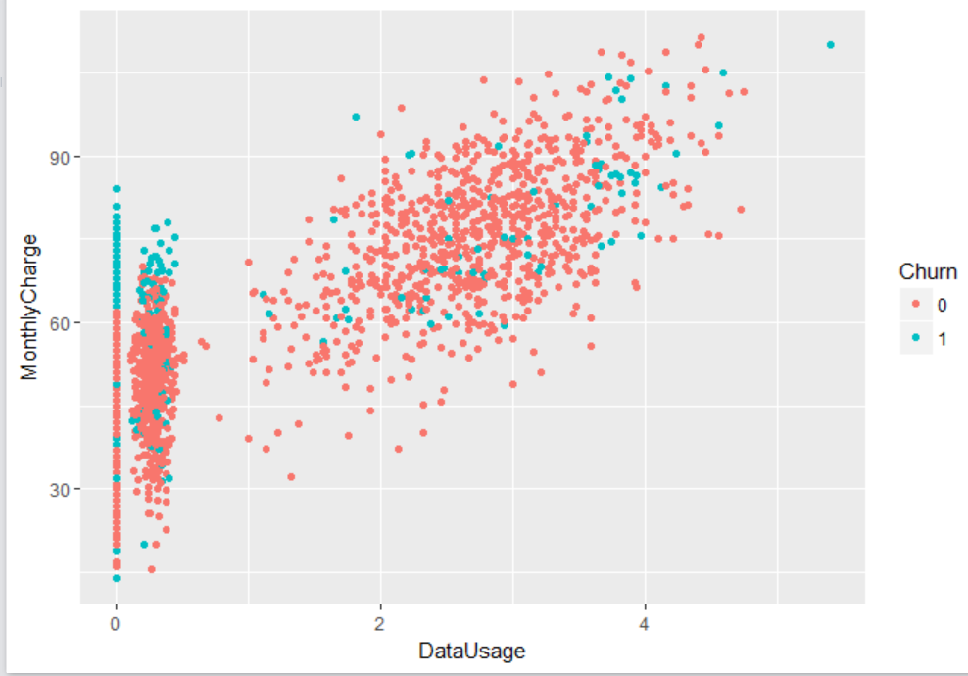
Univariate and Bivariate Analysis
Scatterplot of DataUsage and MonthlyCharge. We do some sort of linear positive correlation.

Slide 8
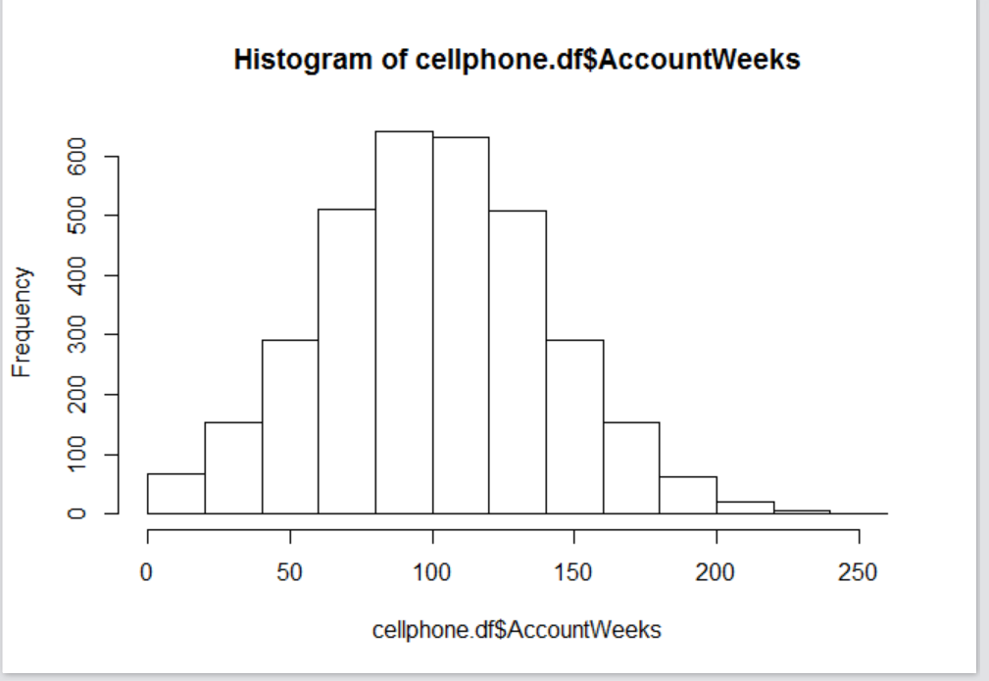
Univariate and Bivariate Analysis
Histogram for Accountweeks which is centered and not skewed.

Slide 9
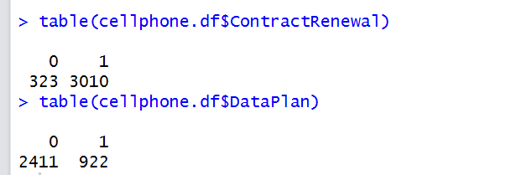
Univariate and Bivariate Analysis
The contingency table for ContractRenewal and DataPlan.
Total 3010 customers went for ContractRenewal. 2411 customers did not take any DataPlan.

Slide 10
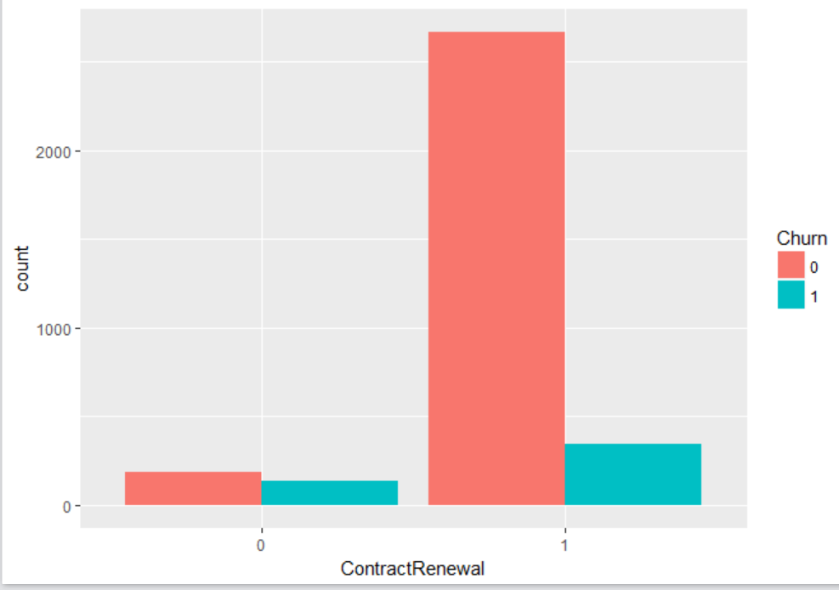
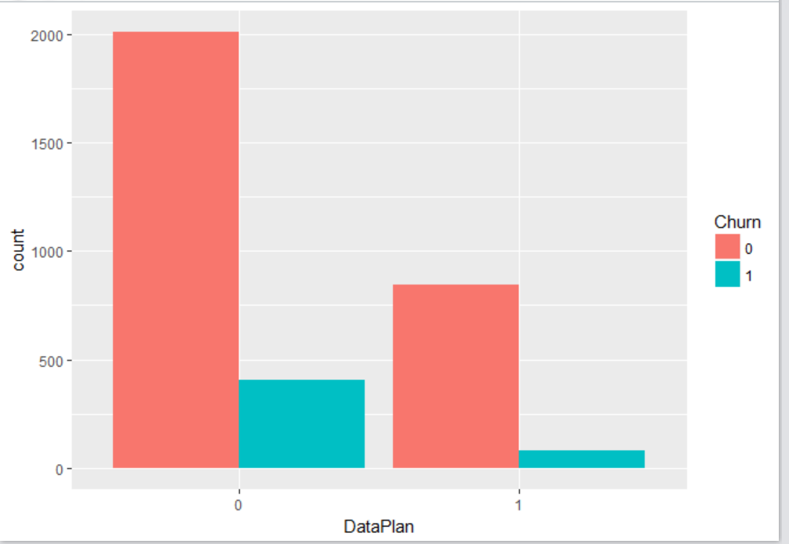
Univariate and Bivariate Analysis
We see more customer churn with low ContractRenewal. Customer churn representation more with no DataPlan as the proportion of customer in this segment is more.

Slide 11
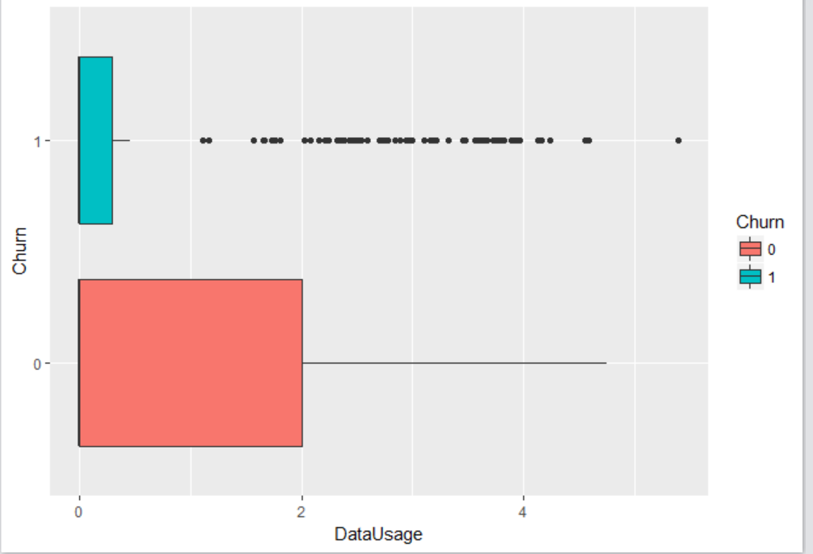
Univariate and Bivariate Analysis
Significant difference in the mean of DataUsage between Churn and No Churn

Slide 12
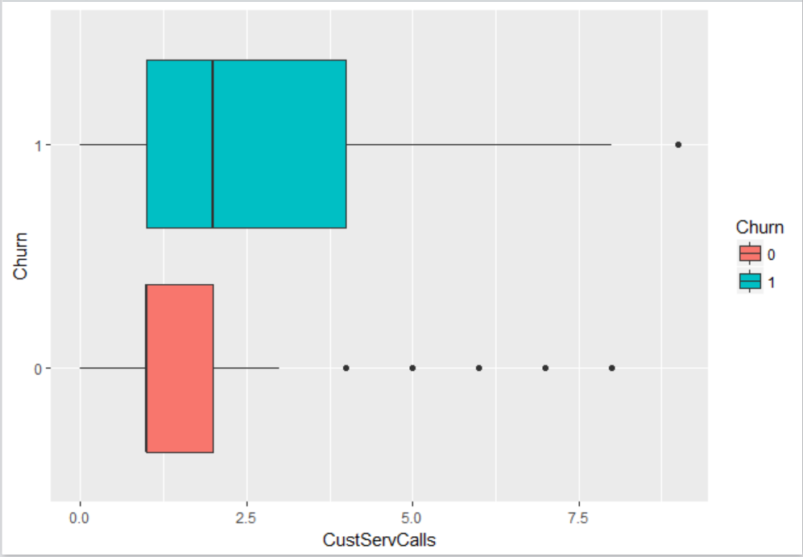
Univariate and Bivariate Analysis
Significant difference in the mean of CusrServCalls between Churn and No Churn

Slide 13
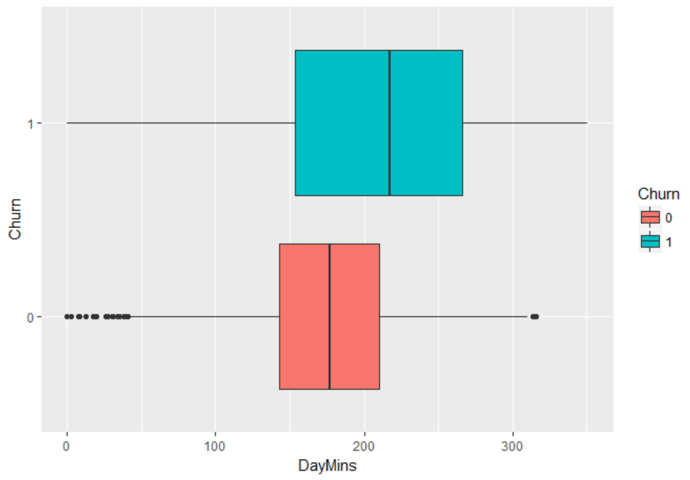
Univariate and Bivariate Analysis
Significant difference in the mean of DayMins between Churn and No Churn

Slide 14
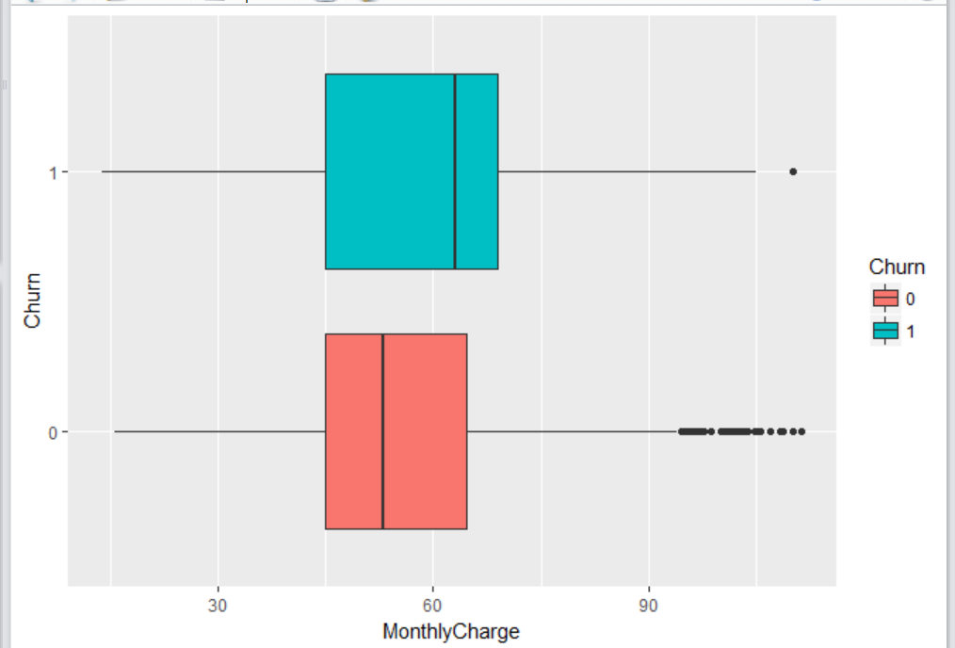
Univariate and Bivariate Analysis
Significant difference in the mean of MonthlyCharge between Churn and No Churn

Slide 15
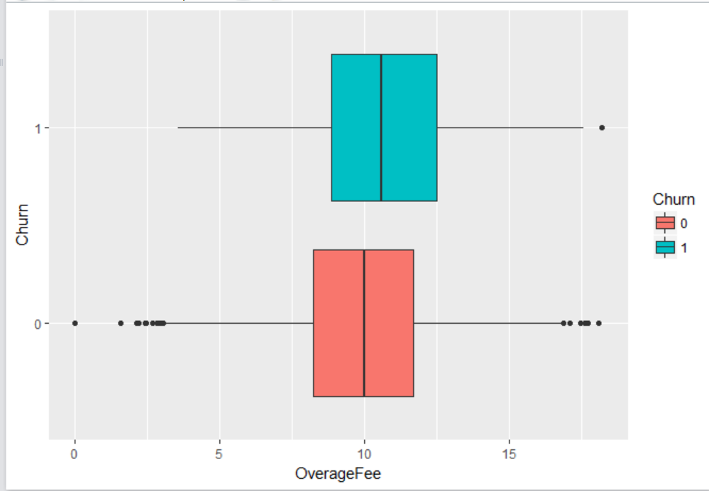
Univariate and Bivariate Analysis
Significant difference in the mean of OverageFee between Churn and No Churn

Slide 16
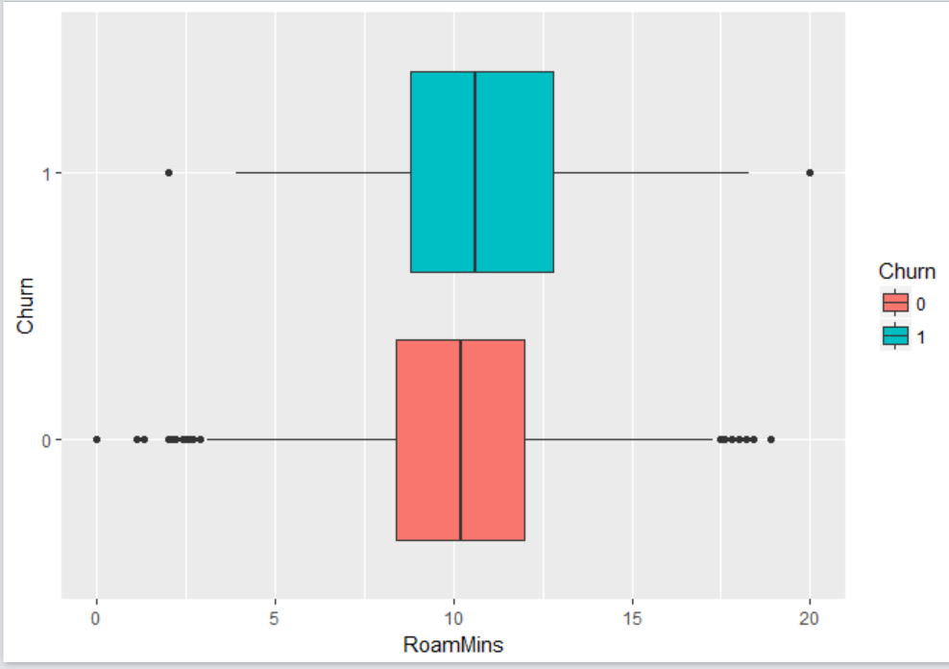
Univariate and Bivariate Analysis
Significant difference in the mean of RoamMins between Churn and No Churn

Slide 17
Anova and Chi Square Test Analysis
ANOVA of AccountWeeks ~ Churn not significant
Chisquare test significant for Churn and Dataplan
Chisquare test significant for Churn and ContractRenewal
Chisquare test not significant for Dataplan and ContractRenewal
Anova of DataUsage and Churn significant
Anova of CustServCalls ~ Churn significant
Anova of DayMins ~ Churn significant
Anova of DayCalls ~ Churn not significant
Anova of MonthlyCharge ~ Churn significant
Anova of OverageFee ~ Churn significant
Anova of RoamMins ~ Churn significant

Slide 18
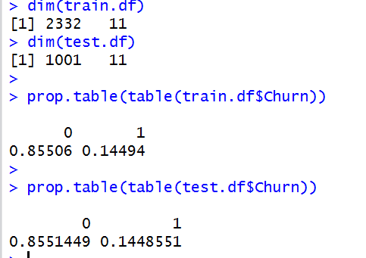
Train and Test Data
# split 70 percent of the data into the training dataset and 30 percent of the data
# into the testing dataset:
set.seed(123)
ind = sample(2, nrow(cellphone.df), replace = TRUE, prob=c(0.7,0.3))
train.df = cellphone.df[ind == 1,]
test.df = cellphone.df[ind == 2,]
# we see almost equal representation in both training and testing set for the dependent or response variable

Slide 19
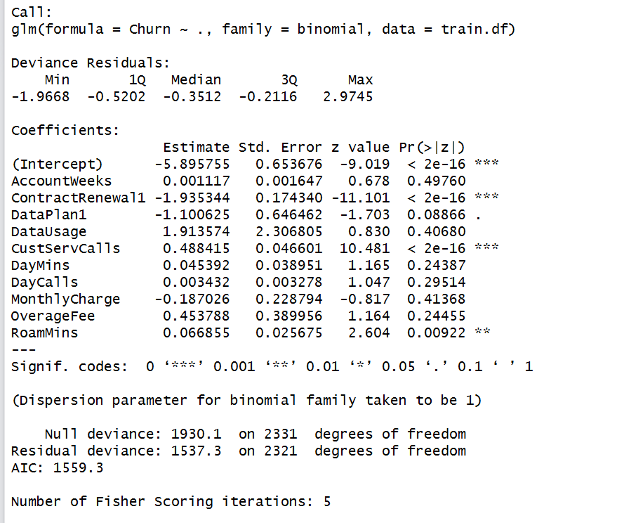
Model 1 with all the independent variables
glmfit <- glm(Churn ~ ., data = train.df, family = binomial)
summary(glmfit)
# the significant coefficients are ContractRenewal, CustServCalls and RoamMins

Slide 20
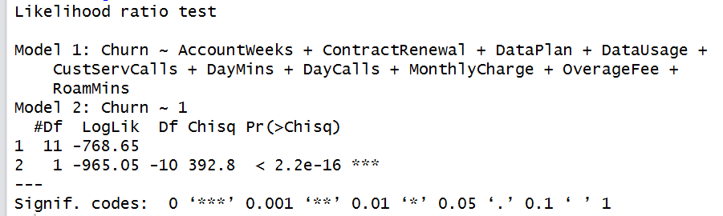
Model 1 with all the independent variables
#Likelihood ratio test
lrtest(glmfit)

Slide 21
Model 1 with all the independent variables
#pseudo R square value
pR2(glmfit)
# 20% in variance explained by all the variables

Slide 22
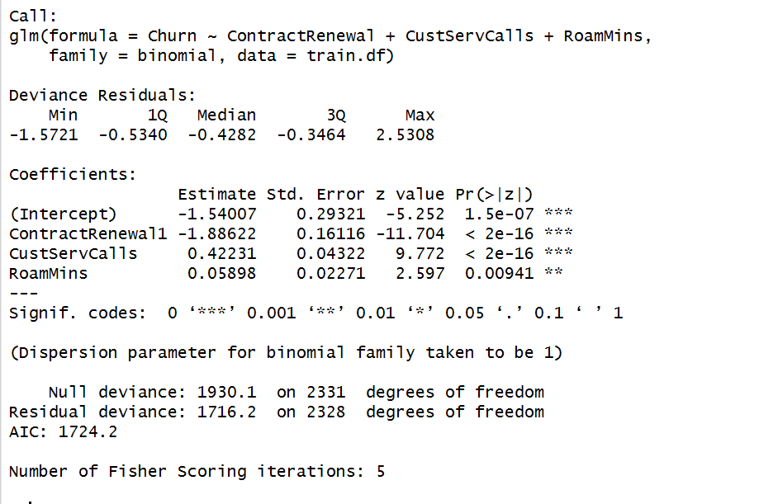
Model 2 with only those 3 significant independent variables
#Model 2 with only the 3 significant variables as explained by the above model
glmfit1 <- glm(Churn ~ ContractRenewal+CustServCalls+RoamMins, data = train.df, family = binomial)
summary(glmfit1)

Slide 23
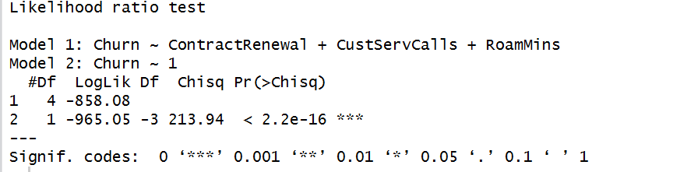
Model 2 with only those 3 significant independent variables
#Likelihood ratio test
lrtest(glmfit1)

Slide 24
Model 2 with only those 3 significant independent variables
#pseudo R square value
pR2(glmfit1)
# 11% in variance explained by the 3 variables

Slide 25
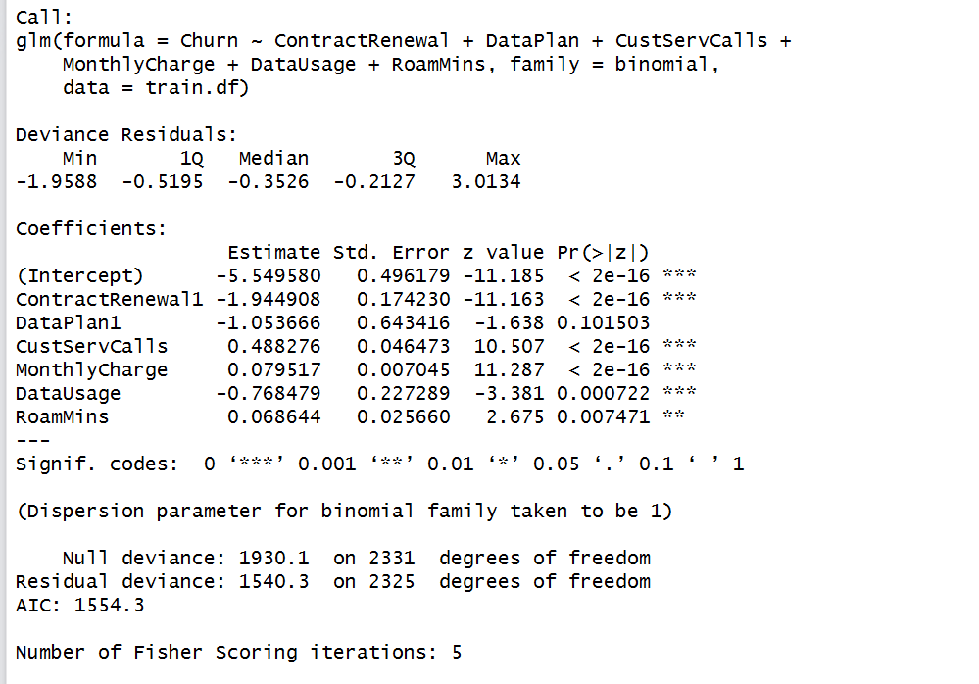
Model 3 with those variables that are significant based on Anova and Chi Square test
Model 3 based on all those variables that are significant based on our ANOVA and Chi Square test. We dropped few as they were masking the effect of the others due to correlation
glmfit2 <- glm(Churn ~ ContractRenewal+DataPlan+CustServCalls+MonthlyCharge+DataUsage+RoamMins, data = train.df, family = binomial)
summary(glmfit2)

Slide 26
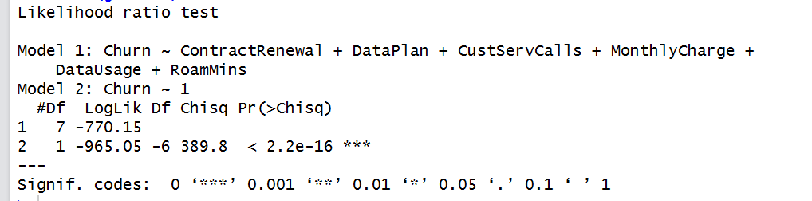
Model 3 with those variables that are significant based on Anova and Chi Square test
#Likelihood ratio test
lrtest(glmfit2)

Slide 27
Model 3 with those variables that are significant based on Anova and Chi Square test
#pseudo R square value
pR2(glmfit2)
# 20% in variance explained by the 3 variables
The Odds calculated from the Beta/Coefficients as shown

Slide 28
Model 3 with those variables that are significant based on Anova and Chi Square test
The Interpretation
If ContractRenewal is taken up then the odds that customer churn will happen is 0.14.
If DataPlan is taken up then the odds that customer churn will happen is 0.35.
If CustServCalls is increased by one unit then the odds that customer will leave is 1.63.
If MonthlyCharge is increased by one unit then the odds that customer will leave is 1.08.
If DataUsage is increased by one unit then the odds that customer will leave is 0.46.
If RoamMins is increased by one unit then the odds that customer will leave is 1.07.

Slide 29
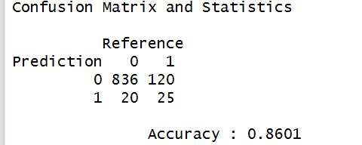

Prediction on the holdout dataset
##test data for our final model glmfit2
pred<-predict(glmfit2,newdata=test.df,type="response")
y_pred_num <- ifelse(pred>0.5,1,0) ## cutoff is at 0.5
y_pred <- factor(y_pred_num, levels=c(0,1))
y_act <- test.df$Churn
confusionMatrix(y_pred,y_act,positive="1") # precision is 56%
Recall is True Positive/(True Positive+False Negative) = 17%,
F score = 0.26 = ( 2* (Precision*Recall)/(Precision+Recall))

Slide 30
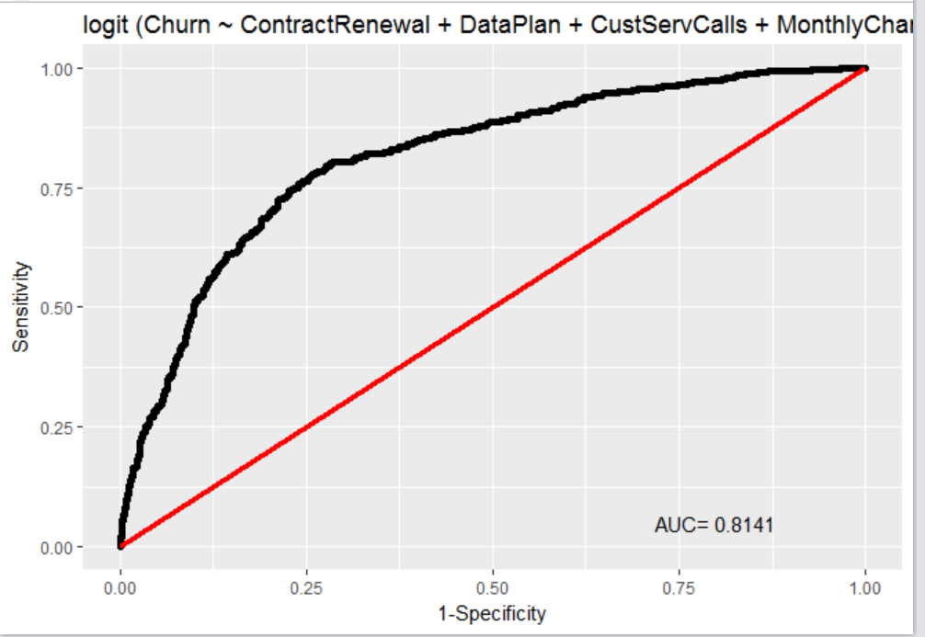
Prediction on the holdout dataset
The ROC plot

Slide 31
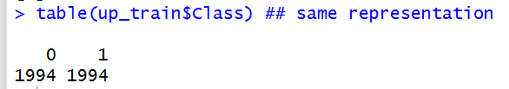
Model with Up-Sampling
up_train <- upSample(x=train.df[, -1],y=train.df$Churn)
dim(up_train)
table(up_train$Class) ## same representation

Slide 32
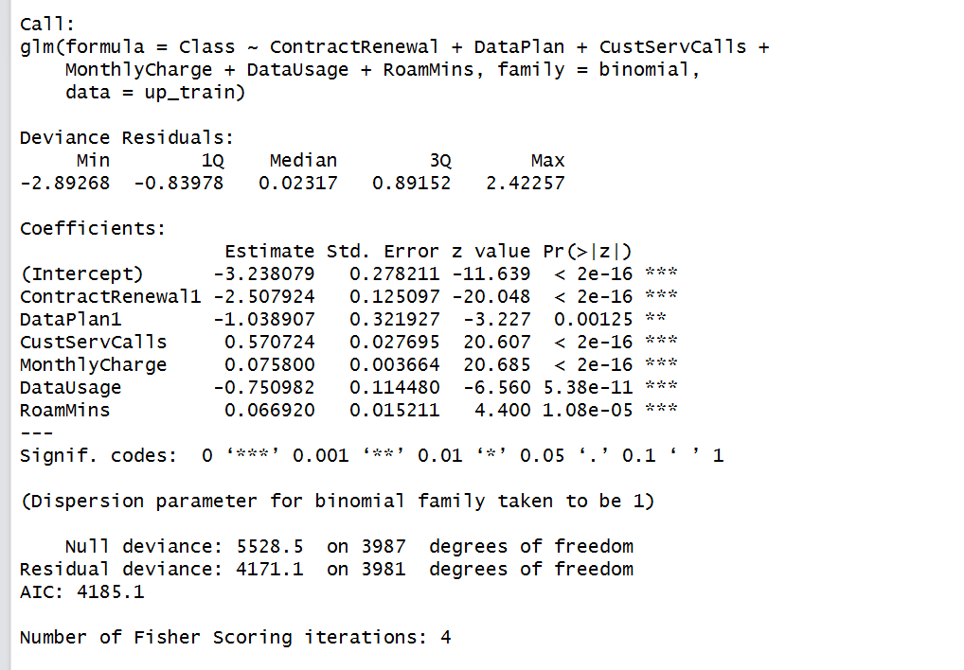
Model with Up-Sampling
glmfit2 <- glm(Class ~ ContractRenewal+DataPlan+CustServCalls+MonthlyCharge+DataUsage+RoamMins, data = up_train, family = binomial)
summary(glmfit2)

Slide 33
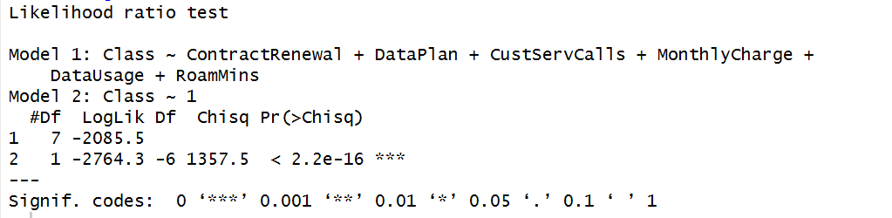
Model with Up-Sampling
#Likelihood ratio test
lrtest(glmfit2)

Slide 34
Model with Up-Sampling
#pseudo R square value
pR2(glmfit2) # 24.6% in variance explained by the 3 variables

Slide 35
Model with Up-Sampling
# the odds ratios
exp(coef(glmfit2))

Slide 36
Model with Up-Sampling (Odds Interpretation)
The Interpretation
If ContractRenewal is taken up then the odds that customer churn will happen to that of not happening is 0.08.
If DataPlan is taken up then the odds that customer churn will happen is 0.35.
If CustServCalls is increased by one unit then the odds that customer will leave to that of not leaving is 1.77.
If MonthlyCharge is increased by one unit then the odds that customer will leave is 1.08.
If DataUsage is increased by one unit then the odds that customer will leave is 0.47.
If RoamMins is increased by one unit then the odds that customer will leave is 1.07.
If we look at the odds values that we have found for each of the independent variables, we can easily observe that the interpretations make sense. For e.g. If a customer renews his/her contract with the company then it usually means that the customer is satisfied with the data provider and his/her chances for churning would be less. On the other hand, if a customer calls the customer service center a lot, may be due to some problems he/she is facing, then it is likely that the customer is not happy and may churn in the future.

Slide 37
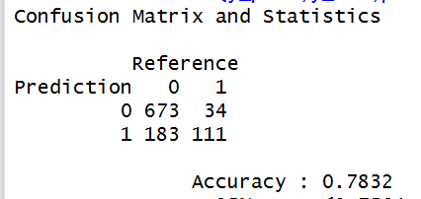

Model with Up-Sampling
##test data
pred<-predict(glmfit2,newdata=test.df,type="response")
y_pred_num <- ifelse(pred>0.5,1,0)
y_pred <- factor(y_pred_num, levels=c(0,1))
y_act <- test.df$Churn
confusionMatrix(y_pred,y_act,positive="1") # on test data Accuracy : 0.8601
Precision is 37%
Recall is 76.6%,
F Score is 0.5

Slide 38
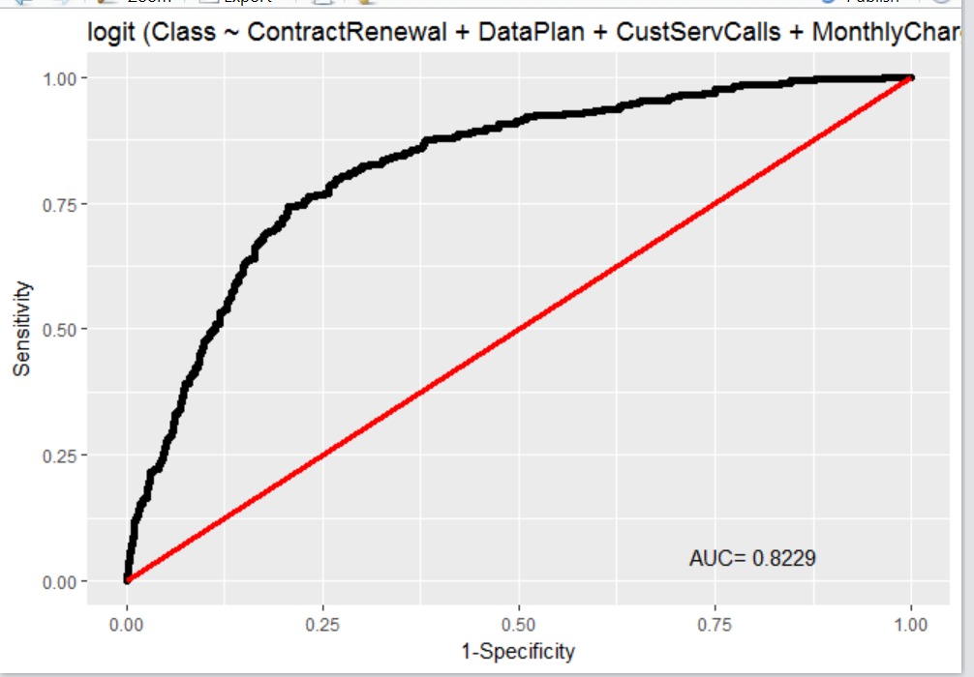
Model with Up-Sampling
## AUC
rocplot(glmfit2) ##0.8229

Slide 39
Final Conclusion and Model Selection
The model accuracy reduced with up-sampling of the minority class. Overall precision decreased from 56% to 37% whereas Recall increased from 17% to 76.6%.
The model accuracy came around 91.36% when we used the ‘step’ function (and taking interactions between the independent variables into account) to decide the model. Overall precision increased from 56% to 76.8% whereas Recall increased from 17% to 55.07%.
The F score which conveys the balance between the precision and the recall increased from 0.26 to 0.5 for up-sampling and to 0.63 by using the ‘step’ function(taking interactions between the independent variables into account).
There is increase in AUC from 81% to 82% for up-sampling and to 89.7% by using the ‘step’ function (taking interactions between the independent variables into account).
Taking this as our baseline model to start with we can go for advanced Algorithms like Neural Network and Ensembles to increase accuracy
OR
If interpretation is important then business can take appropriate decisions with the significant parameters as explained by the final model to reduce the customer churn
Important observations that we came across are that in a Telecom industry, Churning is highly dependent on the No. of Contract Renewals (the more renewals the less churns), Data Plans (the more of them the less chances of churning), No. of times a customer calls the customer care (the more of them the more chances of churning), Average monthly bill (more means chances of churning are more), Gigabytes of monthly data usage (more means chances of churning are less), and Average number of roaming minutes (more means chances of churning are more).

